Slide 1

Master Budgeting
CHAPTER 8
Managerial Accounting
Seventeenth edition
As edited by Prof Duquette 3-25-23

Slide 2
Learning Objective 1
Understand why organizations budget and the processes they use to create budgets.

Slide 3
The Basic Framework of Budgeting
A budget is a detailed quantitative plan for acquiring and using financial and other resources over a specified forthcoming time period.
A company’s budget ordinarily cover a one-year period corresponding to its fiscal year.
Some companies also use a perpetual budget, which is a 12-month budget that continuously rolls forward.

Slide 4
Choosing the Budget Period
Operating Budget
2020
2021
2022
2023
Operating budgets ordinarily
cover a one-year period
corresponding to a company’s fiscal year. Many companies divide their annual budget
into four quarters.
A continuous budget is a 12-month budget that rolls forward one month (or quarter) as the current month (or quarter) is completed.

Slide 5
Budgets are Used for Two Key Purposes:
Planning – involves developing objectives and preparing various budgets to achieve those objectives.
Control – involves the steps taken by management to increase the likelihood that the objectives set down while planning are attained and that all parts of the organization are working together toward that goal.

Slide 6
Why Do Organizations Create Budgets? (Planning Perspective)
Define goals
and objectives
Communicate
plans
Think about and
plan for the future
Benefits
Coordinate
activities
Means of allocating
resources
Uncover potential
bottlenecks

Slide 7
Why Do Organizations Create Budgets? (Control Perspective)
From a control standpoint, organizations compare their budgets to actual results to:
Improve the efficiency and effectiveness of operations.
Evaluate and reward employees.
Notes:
Why Do Organizations Create Budgets? (Control Perspective)

Slide 8
How Do Organizations Create Budgets?
Companies usually create budgets by relying on some combination of top-down budgeting and self-imposed budgeting. A self-imposed budget or participative budget is a budget that is prepared with the full cooperation and participation of managers at all levels.

Slide 9
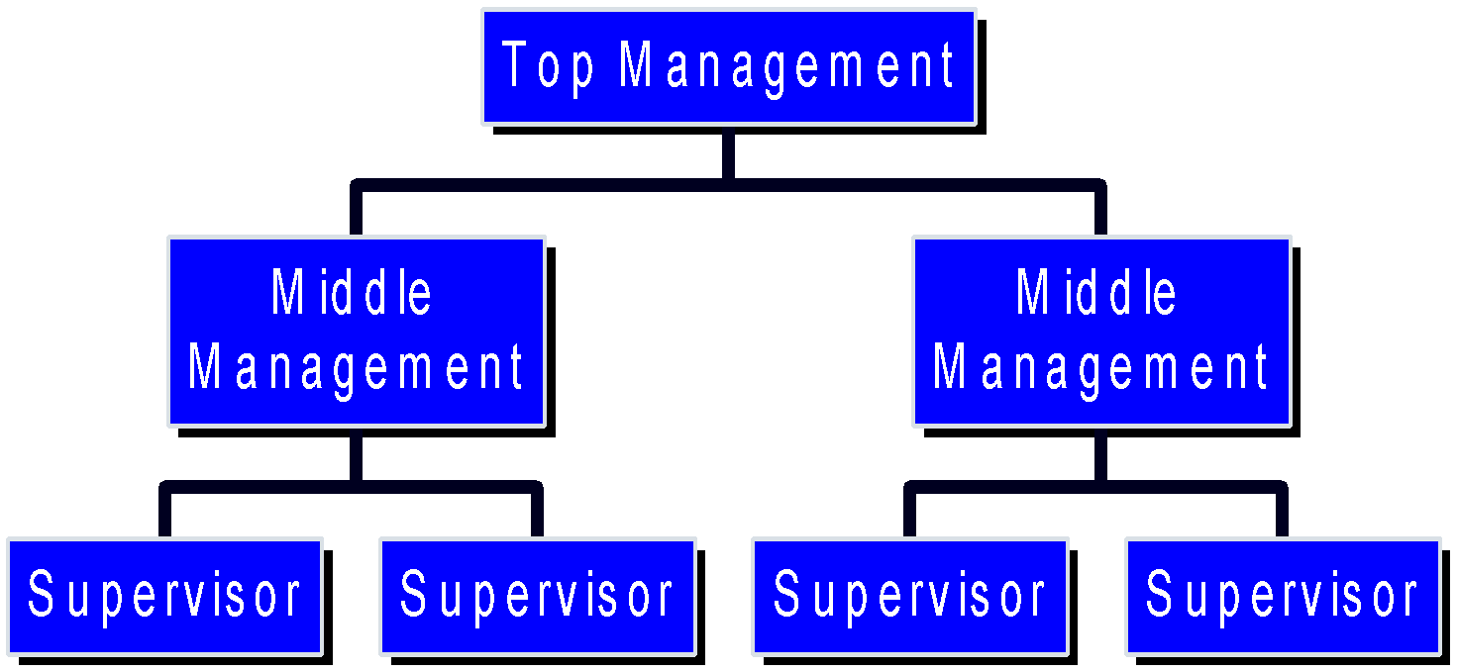
Self-Imposed Budgets
When managers throughout the organization work collaboratively to prepare a budget they often strive to establish challenging targets that are also highly achievable. These goals are likely to build a lower-level manager’s confidence and commitment to the budget

Slide 10
Advantages of Self-Imposed Budgets
It shows respect for their opinions when lower-level managers are involved in the budgeting process.
Budget estimates prepared by front-line managers are often more accurate than estimates prepared by top managers.
Motivation is generally higher when individuals participate in setting their own goals than when the goals are imposed from above.
It empowers them to take ownership of the budget and to be accountable for deviations from it.

Slide 11
Self-Imposed Budgets – Management Review
Self-imposed budgets should be reviewed by higher levels of management to prevent “budgetary slack.”
Most companies issue broad guidelines in terms of overall profits or sales. Lower level managers are directed to prepare budgets that meet those targets.

Slide 12
The Master Budget – An Overview – Part 1
Sales budget
Selling and
administrative
budget
Ending inventory
budget
Production budget
Direct materials
budget
Direct labor budget
Manufacturing
overhead budget
Cash Budget
Budgeted income statement
Budgeted balance sheet

Slide 13
Seeing the Big Picture – Part 1
To help you see the “big picture” keep in mind that the 10 schedules in the master budget are designed to answer the 10 questions shown on the next screen.

Slide 14
Seeing the Big Picture – Part 2
How much sales revenue will we earn?
How much cash will we collect from customers?
How much raw material will we need to purchase?
How much manufacturing costs will we incur?
How much cash will we pay to our suppliers and our direct laborers, and how much cash will we pay for manufacturing overhead resources?
What is the total cost that will be transferred from finished goods inventory to cost of goods sold?
How much selling and administrative expense will we incur and how much cash will we pay related to those expenses?
How much money will we borrow from or repay to lenders – including interest?
How much operating income will we earn?
What will our balance sheet look like at the end of the budget period?

Slide 15
The Master Budget – An Overview – Part 2
A master budget is based on various estimates and assumptions. For example, the sales budget requires three estimates/assumptions as follows:
What are the budgeted unit sales?
What is the budgeted selling price per unit?
What percentage of accounts receivable will be collected in the current and subsequent periods.

Slide 16
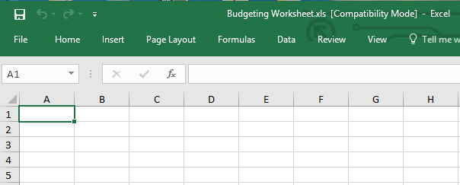
The Master Budget: An Overview – Part 2
When Microsoft Excel© is used to create a master budget, these types of assumptions can be depicted in a Budget Assumptions tab, thereby enabling Excel-based budgets to answer “what-if” questions.

Slide 17
Poll 1
The usual starting point for a master budget is:
the direct materials purchase budget
the budgeted income statement
the sales forecast or sales budget
the production budget

Slide 18
Poll 2
The Direct Materials Budget comes before the Production Budget.
True
False

Slide 19
Learning Objective 2
Prepare a sales budget, including a schedule of expected cash collections.

Slide 20
Budgeting Example
Royal Company is preparing budgets for the quarter ending June 30th.
Budgeted sales for the next five months are:
April 20,000 units
May 50,000 units
June 30,000 units
July 25,000 units
August 15,000 units
The selling price is $10 per unit.

Slide 21
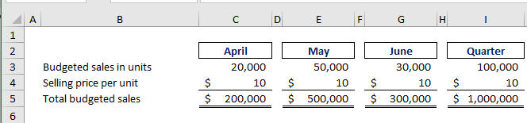
The Sales Budget
The individual months of April, May, and June are summed to obtain the total budgeted sales in units and dollars for the quarter ended June 30th

Slide 22
Expected Cash Collections – Part 1
All sales are on account.
Royal’s collection pattern is:
70% collected in the month of sale,
30% collected in the month following sale,
In April, the March 31st accounts receivable balance of $30,000 will be collected in full in April.

Slide 23
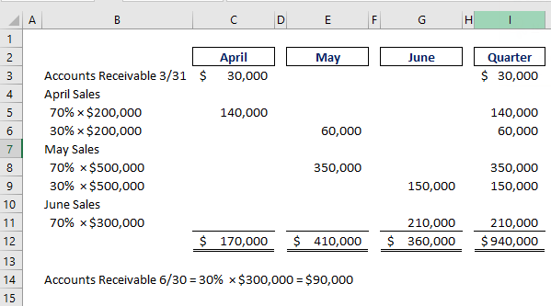
Expected Cash Collections – Part 2

Slide 24
Expected Cash Collections – Part 3
From the Sales Budget for April.

Slide 25
Expected Cash Collections – Part 4
From the Sales Budget for May.

Slide 26
Expected Cash Collections – Part 5

Slide 27
Poll 3
Cash collections in a schedule of cash collections typically consist of collections on sales made to customers in prior periods plus collections on sales made in the current budget period.
True
False

Slide 28
Poll 4
The collection pattern for a company is as follows: 20% in month of sale, 70% in month after sale, and 10% uncollectible. If the sales for May totaled $30,000, what would be the amount of cash collected two months after the sale?
$6,000
$21,000
$3,000
$0

Slide 29
Learning Objective 3
Prepare a production budget.

Slide 30
The Production Budget – Part 1
Sales
Budget and Expected Cash Collections
Production
Budget
Completed
The production budget must be adequate to
meet budgeted sales and to provide for
the desired ending inventory.

Slide 31
The Production Budget – Part 2
The management at Royal Company wants ending inventory to be equal to 20% of the following month’s budgeted sales in units.
On March 31st, 4,000 units were on hand.
Let’s prepare the production budget.
If Royal was a merchandising company it would prepare a merchandise purchase budget instead of a production budget.

Slide 32
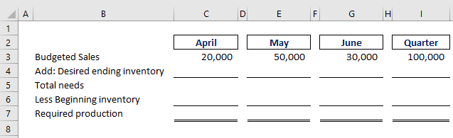
The Production Budget – Part 3

Slide 33
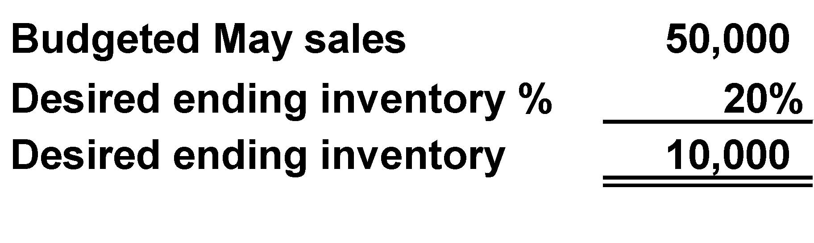
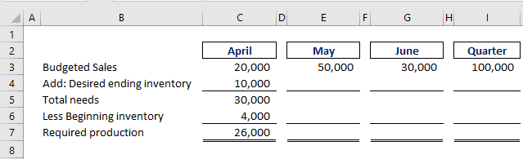
The Production Budget – Part 4
March 31
ending inventory.

Slide 34
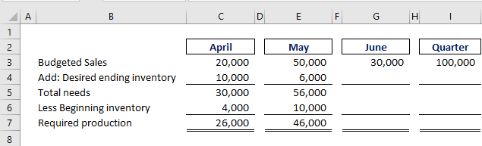
The Production Budget – Part 5

Slide 35
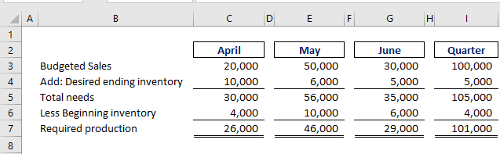
The Production Budget – Part 6
July sales of 25,000 units×20% = 5,000

Slide 36
Poll 5
There are various budgets within the master budget. One of these budgets is the production budget. Which of the following BEST describes the production budget?
It details the required direct labor hours
It details the required raw materials purchases
It is calculated based on the sales budget and the desired ending inventory
It summarizes the costs of producing units for the budget period

Slide 37
Poll 6
The production budget uses dollar amounts in its calculations.
True
False

Slide 38
Learning Objective 4
Prepare a direct materials budget, including a schedule of expected cash disbursements for purchases of materials.

Slide 39
The Direct Materials Budget – Part 1
At Royal Company, five pounds of material are required per unit of product.
Management wants materials on hand at the end of each month equal to 10% of the following month’s production.
On March 31, 13,000 pounds of material are on hand. Material cost is $0.40 per pound.
Let’s prepare the direct materials budget.

Slide 40
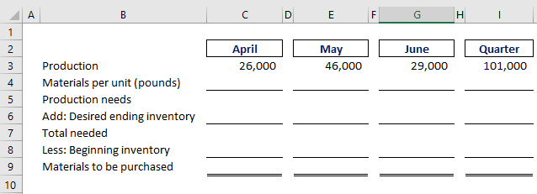
The Direct Materials Budget – Part 2
From production budget.

Slide 41
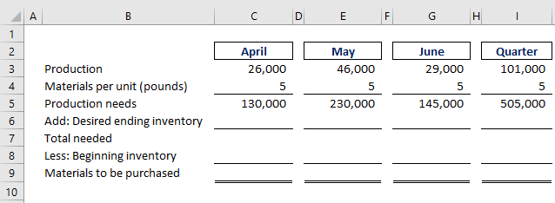
The Direct Materials Budget – Part 3

Slide 42
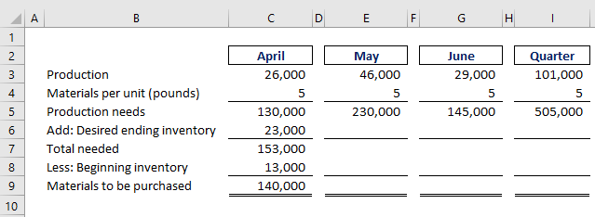
The Direct Materials Budget – Part 4
March 31 inventory.
Now, why don’t you
calculate the materials to be purchased in May.
10% of following month’s production needs.

Slide 43
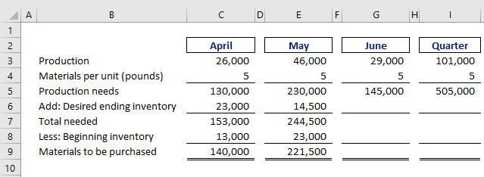
The Direct Materials Budget – Part 5

Slide 44
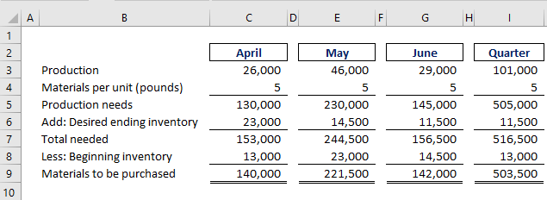
The Direct Materials Budget – Part 6
Beginning inventory from April.

Slide 45
Expected Cash Disbursement for Materials – Part 1
Royal pays $0.40 per pound for its materials.
One-half of a month’s purchases is paid for in the month of purchase; the other half is paid in the following month.
The March 31 accounts payable balance is $12,000.
Let’s calculate expected cash disbursements.

Slide 46
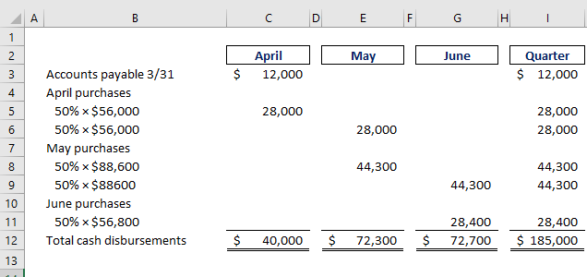
Expected Cash Disbursement for Materials – Part 2

Slide 47
Expected Cash Disbursement for Materials – Part 3
Compute the expected cash disbursements for materials for the quarter.
140,000 lbs. × $0.40/lb. = $56,000

Slide 48
Expected Cash Disbursement for Materials – Part 4
Accounts payable at June 30 = $56,800×50% = $28,400

Slide 49
Poll 7
When preparing a direct materials budget, the required purchases of raw materials in units equals:
raw materials needed to meet the production schedule + desired ending inventory of raw materials − beginning inventory of raw materials
raw materials needed to meet the production schedule − desired ending inventory of raw materials − beginning inventory of raw materials
raw materials needed to meet the production schedule − desired ending inventory of raw materials + beginning inventory of raw materials
raw materials needed to meet the production schedule + desired ending inventory of raw materials + beginning inventory of raw materials

Slide 50
Poll 8
The Direct Materials Budget begins with the expected total produced units in the production budget.
True
False

Slide 51
Learning Objective 5
Prepare a direct labor budget.

Slide 52
The Direct Labor Budget – Part 1
At Royal, each unit of product requires 0.05 hours (3 minutes) of direct labor. The labor can be unskilled because the production process is relatively simple and formal training is not required.
Royal pays its workers at the rate of $10 per hour.
Let’s prepare the direct labor budget.

Slide 53
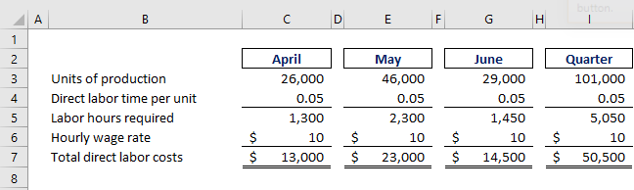
The Direct Labor Budget – Part 2
From production budget.

Slide 54
The Direct Labor Budget – Part 3

Slide 55
The Direct Labor Budget – Part 4

Slide 56
Poll 9
The direct labor budget shows the direct labor-hours required to satisfy the production budget.
True
False

Slide 57
Poll 10
If the units of production for Month 1 are 23,000 and the direct labor per unit is .75, how many labor hours are required for production in Month 1?
5,750 hours
11,500 hours
16,100 hours
17,250 hours

Slide 58
Learning Objective 6
Prepare a manufacturing overhead budget.

Slide 59
Manufacturing Overhead Budget – Part 1
At Royal, manufacturing overhead is applied to units of product on the basis of direct labor hours.
The variable manufacturing overhead rate is $20 per direct labor hour.
Fixed manufacturing overhead is $50,000 per month, which includes $20,000 of noncash costs (primarily depreciation of plant assets).
Let’s prepare the manufacturing overhead budget.

Slide 60
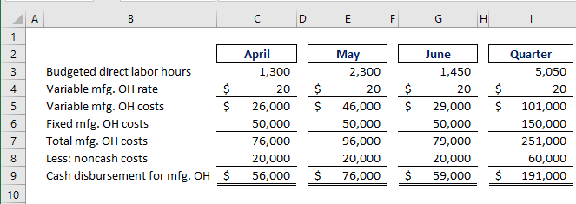
Manufacturing Overhead Budget – Part 2
Direct Labor Budget.

Slide 61
Manufacturing Overhead Budget – Part 3
Total mfg. OH for quarter $251,000 Total labor hours required 5,050
= $49.70 per hour *
* rounded

Slide 62
Manufacturing Overhead Budget – Part 4
Depreciation is a noncash charge.

Slide 63
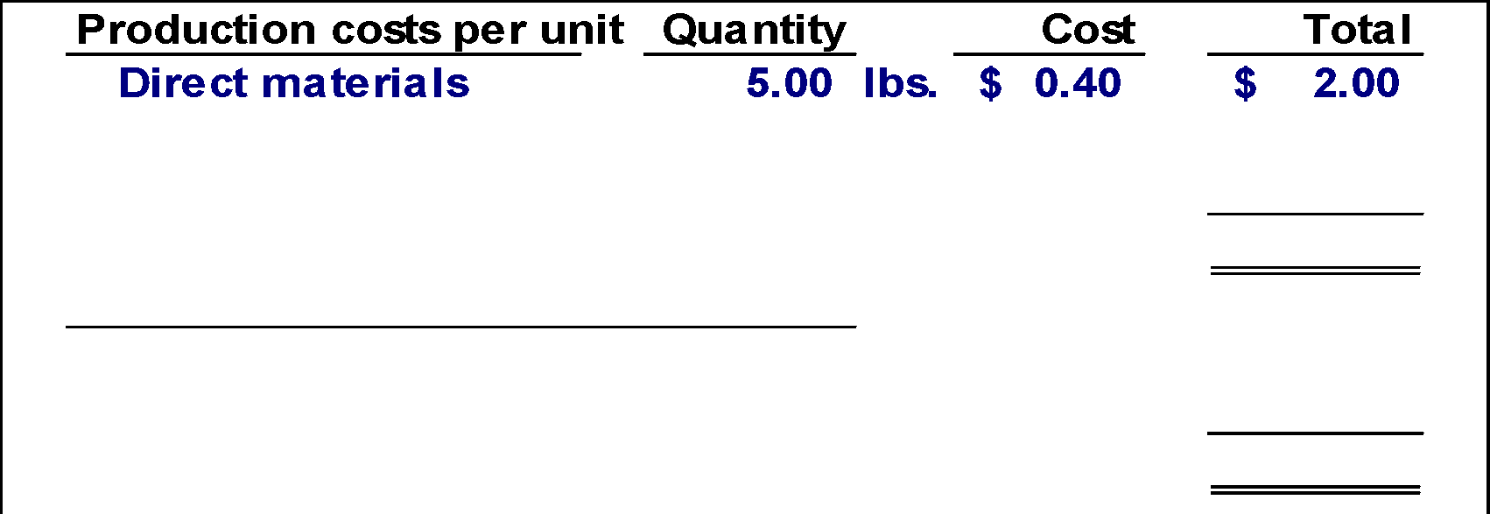
Ending Finished Goods Inventory Budget – Part 1
Direct materials
budget and information.

Slide 64
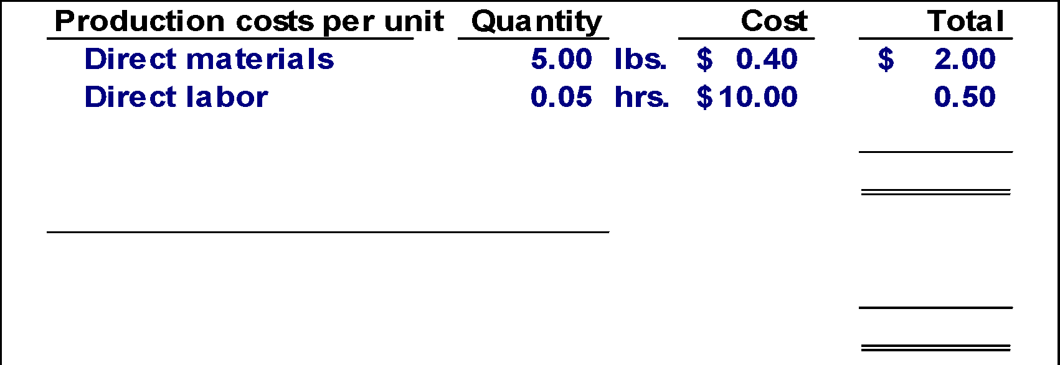
Ending Finished Goods Inventory Budget – Part 2
Direct labor budget.

Slide 65
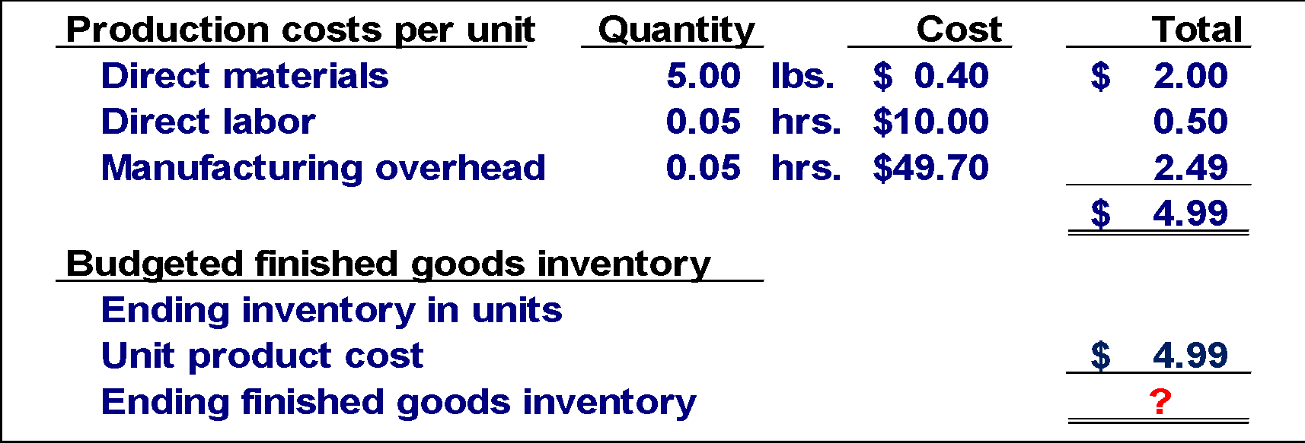
Ending Finished Goods Inventory Budget – Part 3
Total mfg. OH for quarter $251,000 Total labor hours required 5,050
= $49.70 per hour

Slide 66
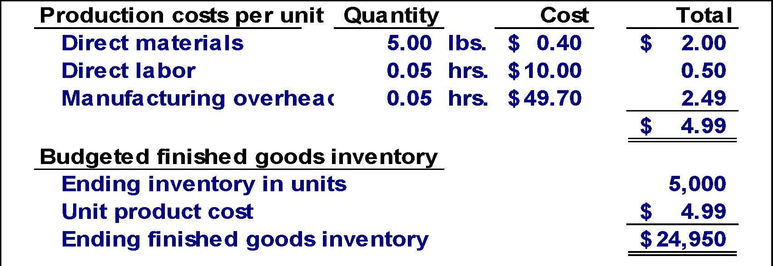
Ending Finished Goods Inventory Budget – Part 4

Slide 67
Ending Finished Goods Inventory Budget – Part 5
Production Budget.

Slide 68
Poll 11
Which of the following statements is NOT correct concerning the Manufacturing Overhead Budget?
The Manufacturing Overhead Budget provides a schedule of all costs of production other than direct materials and labor costs
The Manufacturing Overhead Budget shows only the variable portion of manufacturing overhead
The Manufacturing Overhead Budget shows the expected cash disbursements for manufacturing overhead
The Manufacturing Overhead Budget is prepared after the Sales Budget

Slide 69
Poll 12
The Manufacturing Overhead Budget begins with the budgeted direct labor hours calculated in the Direct Labor Budget.
True
False

Slide 70
Learning Objective 7
Prepare a selling and administrative expense budget.

Slide 71
Selling and Administrative Expense Budget – Part 1
At Royal, the selling and administrative expense budget is divided into variable and fixed components.
The variable selling and administrative expenses are $0.50 per unit sold.
Fixed selling and administrative expenses are $70,000 per month.
The fixed selling and administrative expenses include $10,000 in costs – primarily depreciation – that are not cash outflows of the current month.
Let’s prepare the company’s selling and administrative expense budget.

Slide 72
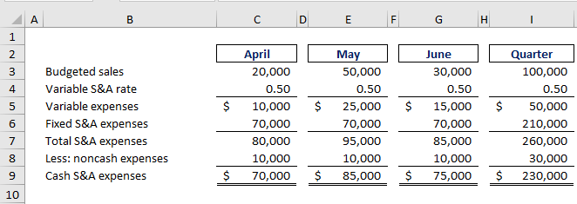
Selling and Administrative Expense Budget – Part 2
Calculate the selling and administrative cash expenses for the quarter.

Slide 73
Selling Administrative Expense Budget – Part 3

Slide 74
Poll 13
The selling and administrative expense budget lists all costs of production other than direct materials and direct labor.
True
False

Slide 75
Poll 14
The Selling and Administrative Budget uses all of these costs to calculate budgeted selling and administrative expense EXCEPT:
corporate salaries
work-in-process inventory
shipping expense
cost of renting company cars

Slide 76
Learning Objective 8
Prepare a cash budget.

Slide 77
Format of the Cash Budget
The cash budget is divided into four sections:
Cash receipts section lists all cash inflows excluding cash received from financing;
Cash disbursements section consists of all cash payments excluding repayments of principal and interest;
Cash excess or deficiency section determines if the company will need to borrow money or if it will be able to repay funds previously borrowed; and
Financing section details the borrowings and repayments projected to take place during the budget period.

Slide 78
Additional Cash Budget Information
Assume the following information for Royal:
Maintains a 16% open line of credit for $75,000.
Maintains a minimum cash balance of $30,000.
Borrows on the first day of the month and repays loans on the last day of the month.
Pays a cash dividend of $49,000 in April.
Purchases $143,700 of equipment in May and $48,300 in June (both purchases paid in cash).
Has an April 1 cash balance of $40,000.

Slide 79
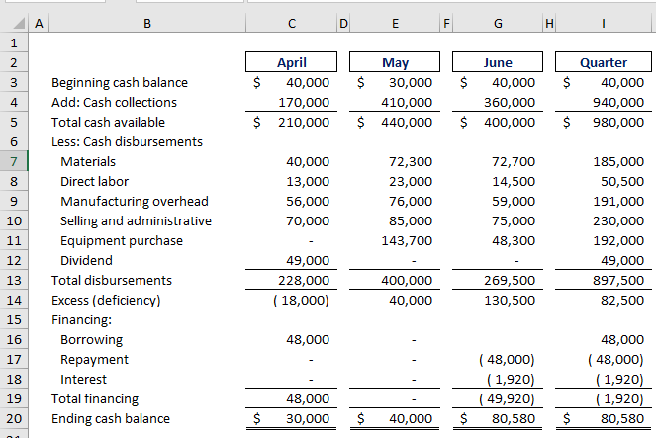
The Cash Budget – Part 1
Schedule of Expected
Cash Collections.

Slide 80
The Cash Budget – Part 2
Schedule of Expected
Cash Disbursements.
Manufacturing
Overhead Budget.
Selling and Administrative
Expense Budget.

Slide 81
The Cash Budget – Part 3
Because Royal maintains
a cash balance of $30,000,
the company must borrow $48,000 on its line-of-credit.

Slide 82
The Cash Budget – Part 4
Because Royal maintains
a cash balance of $30,000,
the company must borrow $48,000 on its line-of-credit.
Ending cash balance for April
is the beginning May balance.

Slide 83
The Cash Budget – Part 5

Slide 84
The Cash Budget – Part 6
$48,000 × 16% × 3/12 = $1,920 Borrowings on April 1 and repayment on June 30.

Slide 85
Poll 15
Which of the following statements is NOT correct concerning the Cash Budget?
It is not necessary to prepare any other budgets before preparing the Cash Budget
The Cash Budget should be prepared before the Budgeted Income Statement
The Cash Budget should be prepared before the Budgeted Balance Sheet
The Cash Budget builds on earlier budgets and schedules as well as additional data

Slide 86
Poll 16
The Cash Budget is a comprehensive budget that pulls monetary amounts from almost every budget that came before it.
True
False

Slide 87
Learning Objective 9
Prepare a budgeted income statement.

Slide 88
The Budgeted Income Statement – Part 1
Cash
Budget
Budgeted
Income
Statement
Completed
With interest expense from the cash budget, Royal can prepare the budgeted income statement.

Slide 89
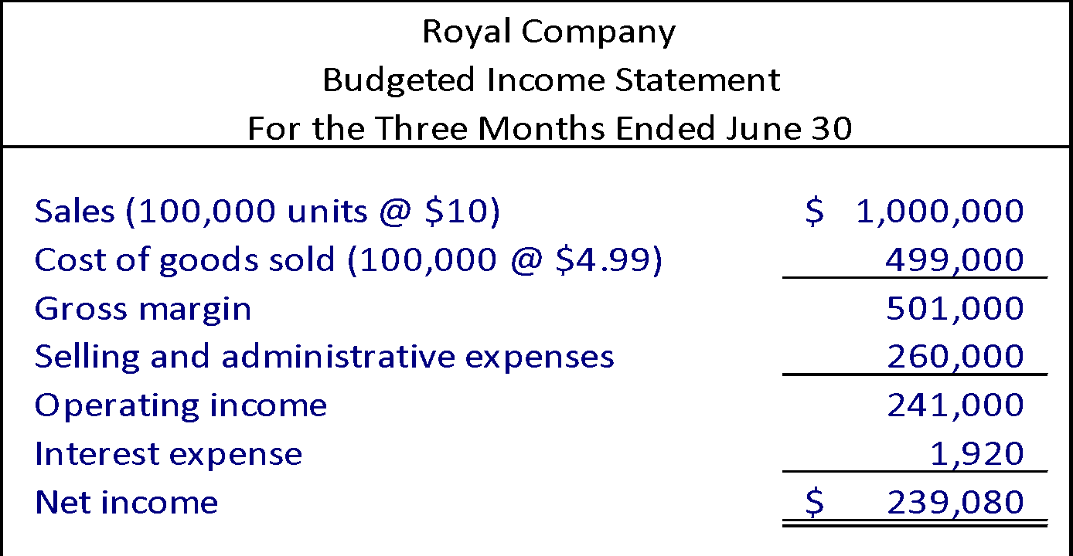
The Budgeted Income Statement – Part 2
Sales Budget.
Ending Finished Goods Inventory.
Selling and Administrative Expense Budget.
Cash Budget.

Slide 90
Poll 17
The Budgeted Income Statement comes before the Cash Budget because the Budgeted Income Statement does not require any information from the Cash Budget.
True
False

Slide 91
Poll 18
If the quarterly budgeted sales from the Sales Budget equals 50,000 units, the budgeted price per unit is $10, and the budgeted gross margin is $100,000, what is budgeted cost of goods sold?
$400,000
$350,000
$375,000
$100,000

Slide 92
Learning Objective 10
Prepare a budgeted balance sheet.

Slide 93
Additional Budgeted Balance Sheet Information
Royal reported the following account balances prior to preparing its budgeted financial statements:
Land - $50,000
Common stock - $150,000
Retained earnings - $248,650 (April 1)
Equipment - $175,000

Slide 94
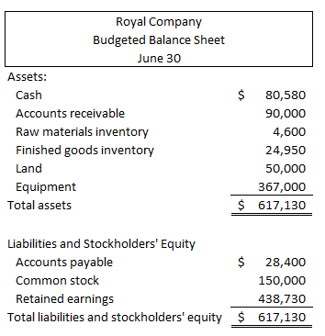
Budgeted Balance Sheet – Part 1
30% of June
sales of
$300,000.
11,500 lbs.
at $0.40/lb.
5,000 units
at $4.99 each.
50% of June
purchases
of $56,800.

Slide 95
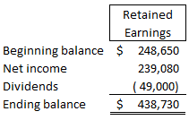
Budgeted Balance Sheet – Part 2

Slide 96
Poll 19
If beginning retained earnings is equal to $50,000, net income is equal to $100,000, and dividends are equal to $70,000, what is the retained earnings amount shown on the Budgeted Balance Sheet?
$90,000
$80,000
$70,000
$60,000

Slide 97
Poll 20
In the Budgeted Balance Sheet, Total Budgeted Assets should be equal to Total Budgeted Liabilities.
True
False

Slide 98
End of Chapter 8

